Slide 1



EML 4551C SENIOR DESIGN
DR. KAMAL AMIN
TEAM 4: ALTERATE MATERIAL SELECTION FOR COMPRESSOR CASING IN TURBOCHARGER final presentation spring 2014
Group Members alexander Mankin
HARRISON MCLARTY
Abiodun OLUWALOWO
Ralph Scott
Project sponsor AND FACULTY Adviser
Cummins - Roger England
DR. PETER KALU
17 APRIL 2014

Slide 2
Outline
Project Scope
Project Background
Project Objectives
Design Concepts
Design Analysis
Challenges Encountered
What we learned
Future Work Suggestions
Final Summary
References
Questions

Slide 3
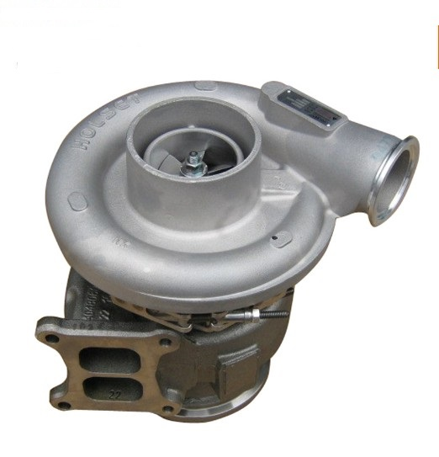
Project Scope
Cummins has an interest in researching and selecting alternate materials to fabricate compressor casings in their B series turbochargers
This alternate material should ultimately be more cost effective than the current one in use, cast aluminum 356, and still satisfy the design and operational parameters set by Cummins
Fig.1: View of turbocharger compressor casing.[5]
Estimates of manufacturing costs for this alternate material and verification of burst containment are essential
Harrison McLarty

Slide 4
Project Background
In industry more cost efficient materials are always being researched
Finding new materials which could replace cast aluminum 356 presents many beneficial opportunities for Cummins
The revenue gained from more cost efficient materials and manufacturing processes present financial advantages for Cummins
Production numbers on compressor casings and turbochargers have the potential to grow allowing the company to meet and exceed the expectations of customers
Harrison McLarty

Slide 5
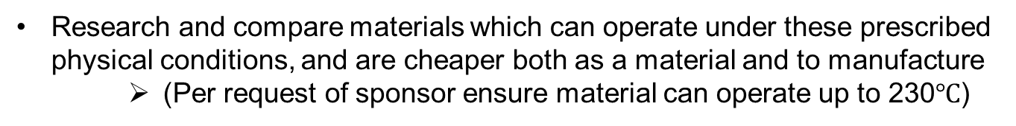
Project Objectives
Analyze the temperatures, pressures, and stresses experienced by casing
Research and compare materials which can operate under these prescribed physical conditions, and are cheaper both as a material and to manufacture
    (Per request of sponsor ensure material can operate up to 230$℃$)
Estimate manufacturing costs with alternate material and fabrication process
Use finite element analysis to test if alternate material can contain burst event
Obtain prototypes of these casings for demonstration
Harrison McLarty

Slide 6
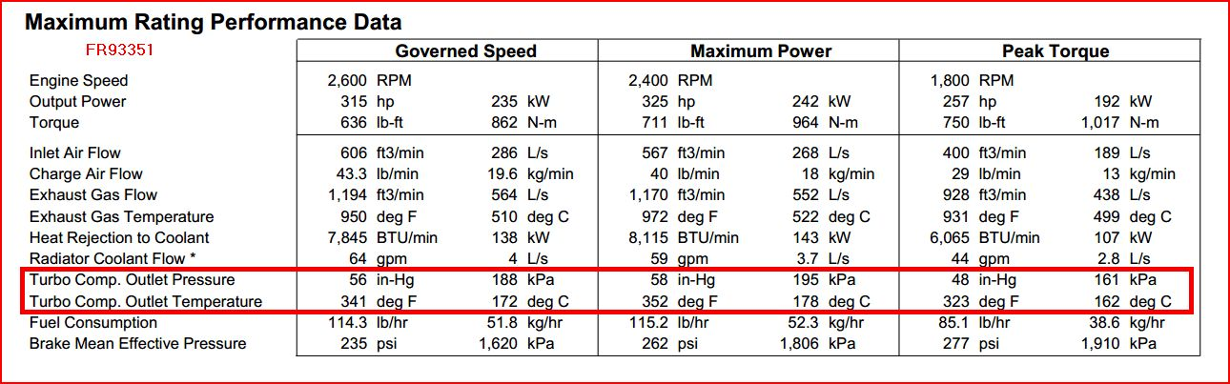
Design Concepts
Operational Conditions for Compressor
Figure 2. Experimental data of turbocharger supplied by sponsor
Harrison McLarty

Slide 7
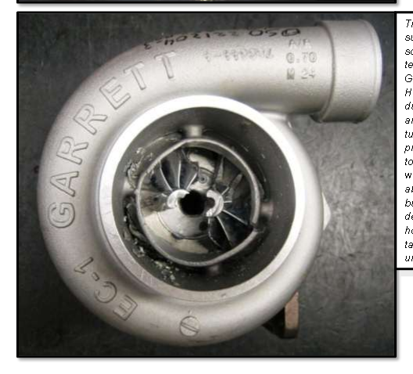
Design Concepts: Need for burst analysis
“Burst” occurs when the centrifugal force undergone by impeller wheels, due to their rotational speed, overcome the mechanical strength of the wheel.
Causes of a burst event include:
  Reduction of strength (high internal stresses)
  Fatigue failure due to cyclic loading
  Foreign object damage (FOD)
Fig.3 Example of a burst containment test. [5]
Although a rare event, this must be considered when selecting materials for the compressor housing due to safety concerns
Materials with the proper yield strength, % elongation (ductility), and maximum operational temperature must be considered to withstand this event.
Harrison McLarty

Slide 8
Design Concepts: Material Properties
Mechanical Property | Cast Aluminum 356 | Torlon | PEEK
Tensile Strength (MPa) | 124 | 152 | 115
Tensile Elongation (%) | 3 | 7.6 | 20
Tensile Modulus (Gpa) | 72.4 | 4.48 | 4.3
Flexural Modulus (Gpa) | N/A | 3.59@232°C | 4.1
Glass Transition Temperature (°C) | N/A | 270 | 162
Coefficient of Thermal Expansion (µm/m*°C) | 23.2 | 31 | 75
Melting Temperature (°C) | 677-816 | 275 | 373
Fig. 4 Mechanical properties of materials considered for analysis
Alex Mankin
Notes:
1.This slide shows the properties of the original Aluminum 356 alloy along with the two possible material canidates which we researched.
2. These materials are Torlon( a Polyamide-imide) and PEEK(Polyether-ether keytone), Interesting Note: Torlon was a material used to make the block of a race car engine which raced during the 80’’s
3. Both of these were chosen due their relatively high temperatures and decent ductility which can be descirned by their Young’s Modulus and % elongation values
4. However it is apparent that their properties are lower than that of the aluminum which shows the need for Finite element analysis to determine their ability to be used.

Slide 9
Design Concepts: Finite Element Analysis
The finite element analysis was performed in COMSOL Multiphysics
It was done on each of the possible materials
Maximum Operating Conditions Analysis:
The maximum conditions used in the analysis were provided by Cummins
Burst Containment Analysis:
Performed for two different compressor wheel speeds, 90,000 and 120,000 rpm
Compressor wheels usually fracture into two or three pieces
Impact speed was found using the relationship between rotational kinetic energy and kinetic energy of a rigid body
This speed was used to approximate force
Alex Mankin
Notes:
This analysis was performed using COMSOL Multiphysics and was done on each of the possible material candidates
There were two different analyses which were performed 1. Maximum Operating Conditions analysis 2. Burst Containment Analysis
1. Max Operating
The maximum operating condition analysis had boundary conditions based on the operating conditions provided by Cummins which Harrison already discussed
2. Burst Containment
-Performed at two compressor wheel speeds , 90,000 and 120,000 rpm
-90,000 being the recommended maximum limit by cummins, 120,000 to demonstrate what would occur during an over spooling event
Impact speed was approximated by using the relationship between rotational kinetic energy and kinetic energy of a rigid body
This speed was then used determine the force at which each piece of the compressor struck the walls of the casing

Slide 10
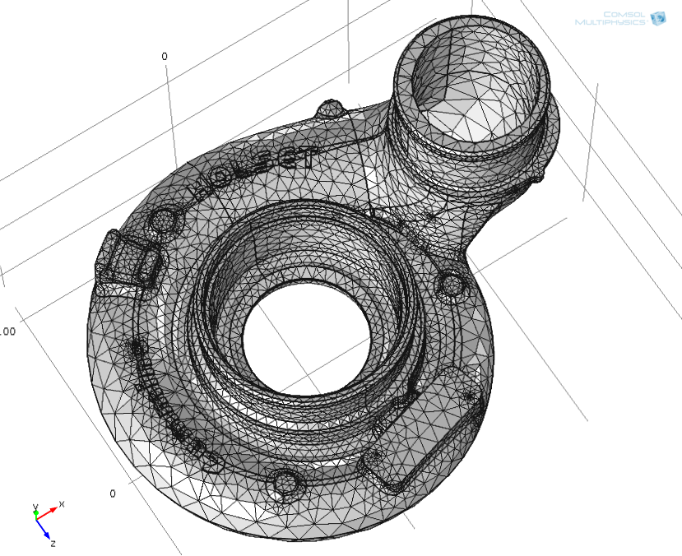
Casing Finite Element Analysis
Fig. 5 Casing Geometry which was imported into COMSOL
Alex Mankin
Notes:
Here is a picture of the geometry which was imported into comsol, it is an exact replica of the current one which is produced

Slide 11
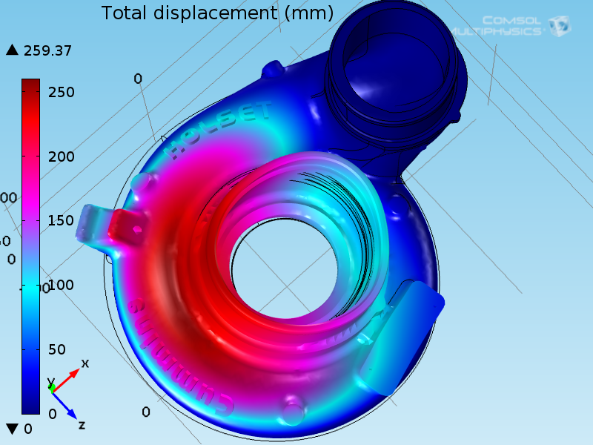
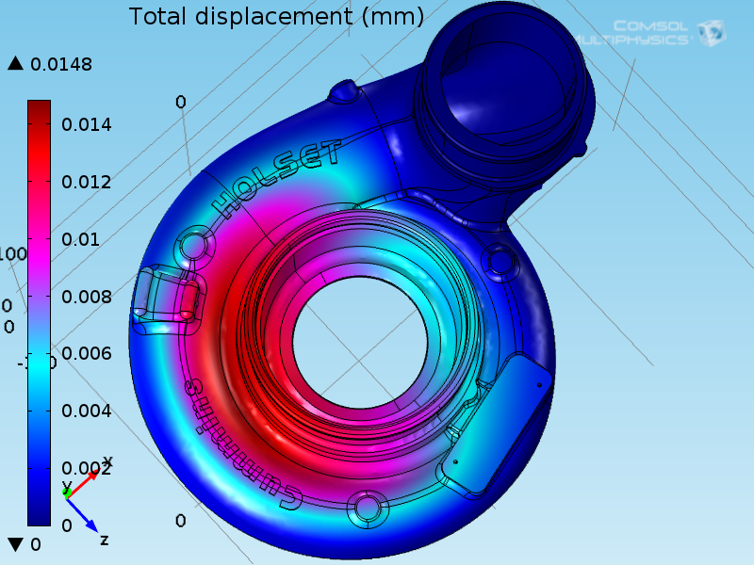
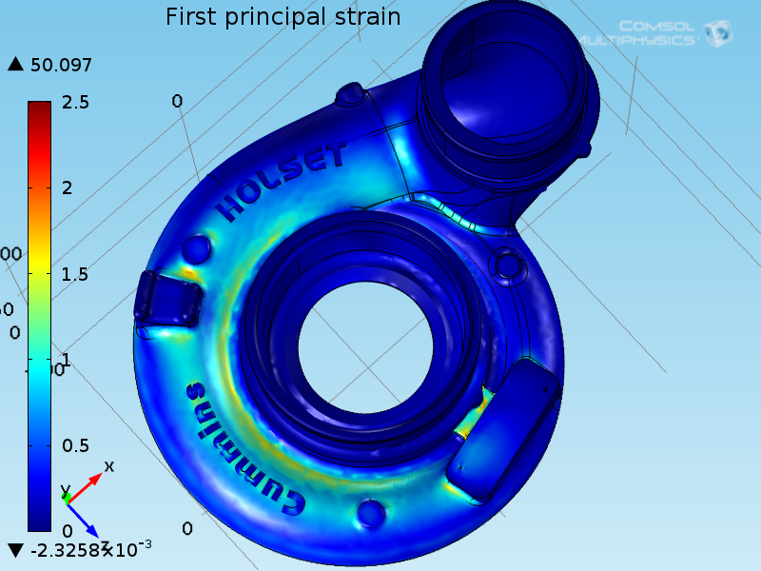
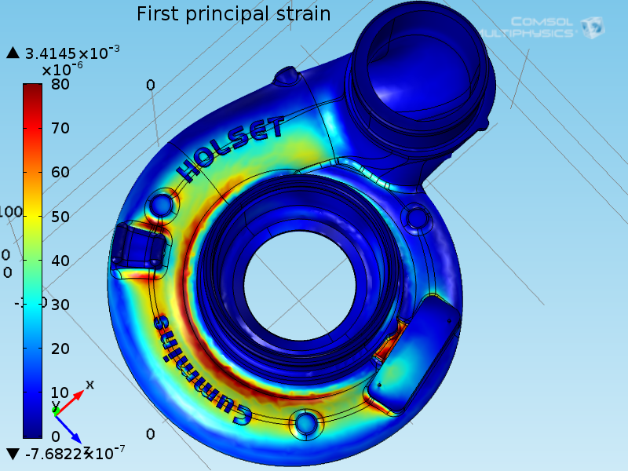
Analysis Results: Maximum Operating Conditions
Fig. 6 PEEK Strain and Displacement(mm)
Fig.7 Aluminum 356 Strain and Displacement(mm)
Alex Mankin
Notes:
This slide shows the results of the simulation on the casing at maximum operating conditions from PEEK and Aluminum A356
The left hand side shows the strain and displacement results for the PEEK casing and the right hand side contains the A356 results
As you can see here, there is a large amount of deformation in the PEEK casing when compared to A356.(Point to PEEK and then Aluminum)
The bottom strain figures also show results which mirror this.
This deformation is due to the temperature being above PEEKS glass transition temperature

Slide 12

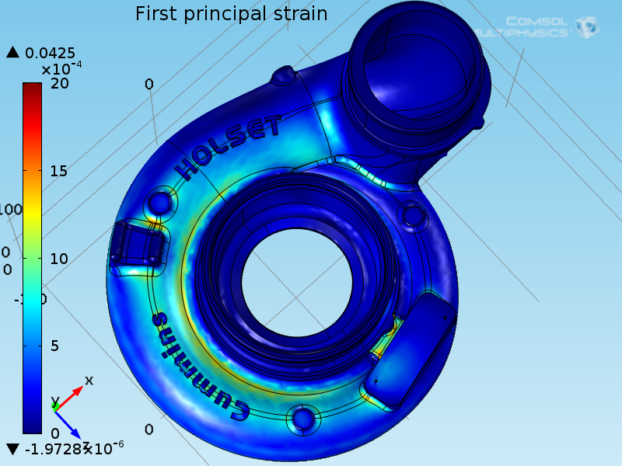
Analysis Results: Maximum Operating Conditions
Fig. 8 Torlon Strain and Displacement(mm)
Fig.9 Aluminum 356 Strain and Displacement(mm)
Alex Mankin
Notes:
This slide also shows the results of the maximum operating conditions analysis, with Torlon being analyzed
The results shows that the Torlon will not deform during conditions such as these as you can see here and here
The strain results also back this up

Slide 13
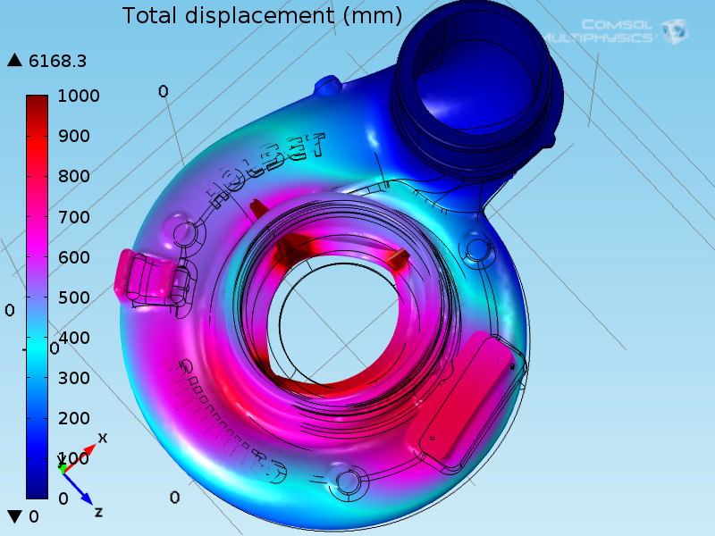
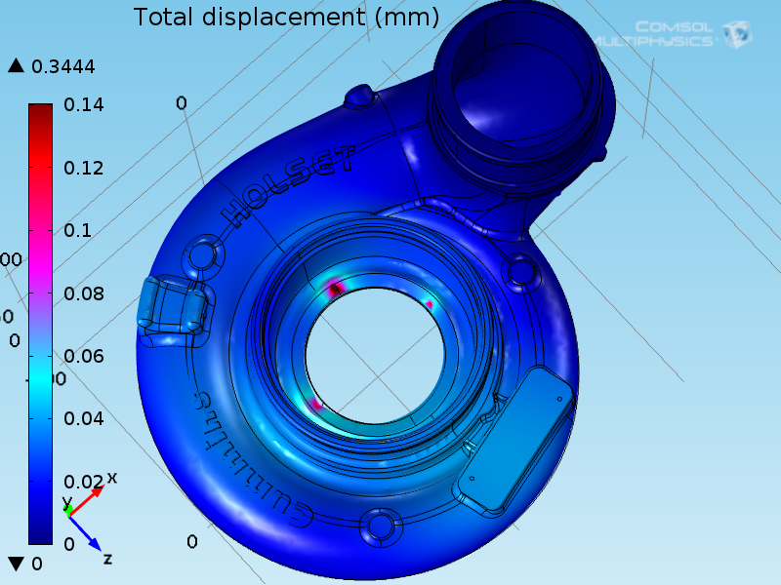
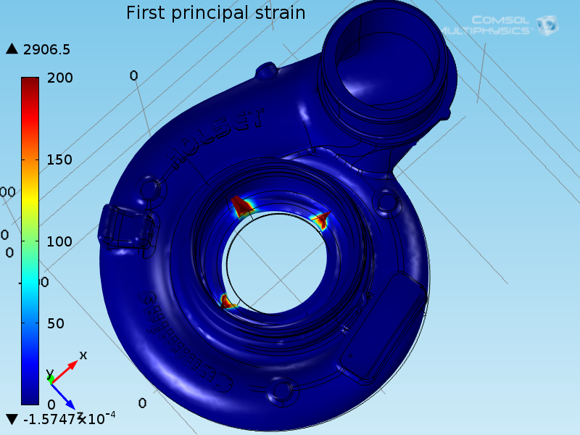
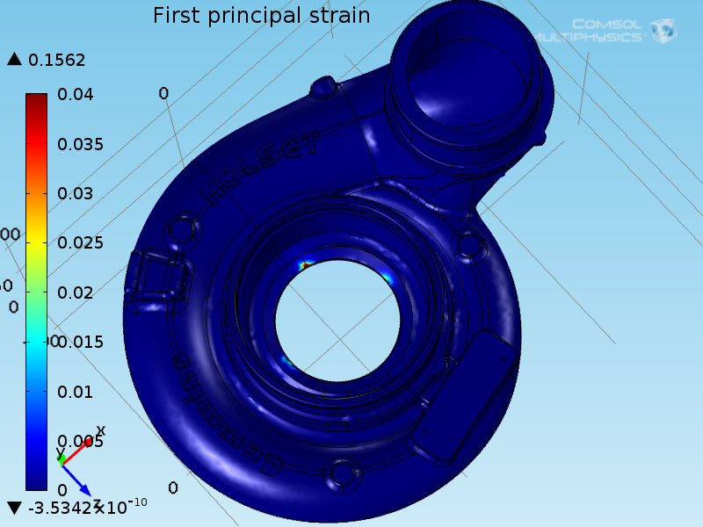
Analysis Results: Burst Containment at 120,000 rpm
Fig. 10 PEEK Strain and Displacement(mm)
Fig.11 Aluminum 356 Strain and Displacement(mm)
Alex Mankin
Notes:
Allright now I am going to discuss the burst containment results.
This presentation only shows the results of a burst event for 120,000 rpm as the simulation for the burst event at 90,000 resulted is similar results
The results show that a casing made out of PEEK would catastrophically fail in the event of something similar to this
They also show that the aluminum would able to handle the burst event adequately with some, but minor, deformation

Slide 14
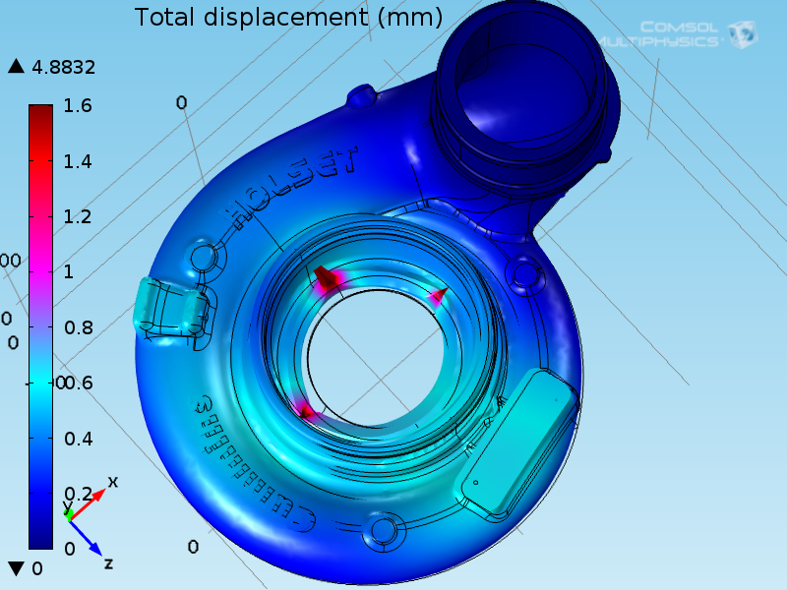

Analysis Results: Burst Containment at 120,000 rpm
Fig. 12 Torlon Strain and Displacement(mm)
Fig.13 Aluminum 356 Strain and Displacement(mm)
Alex Mankin
Notes:
The analysis also found that Torlon would respond much better than PEEK but still not as well the aluminum alloy
This can be seen by looking here and here
These results do show that Torlon would be able to contain the burst event in a safe manner

Slide 15
Design Concepts: Cost Analysis
Material | Cost
Torlon | $25-30/lb
PEEK | $10/lb +
Aluminum 356 | $1.28/lb
Fig. 14 The cost of the two selected materials
Ralph Scott

Slide 16
Design Concepts: Cost Analysis
Injection Molding Cost Analysis
Mold Costs
The cost of a mold can vary greatly based on complexity, quality, and size.
After speaking to several Florida based injection molding companies, we have determined that we will require a two piece mold, with a price range of : $ 42,000 – 50,000
Cost Analysis Method
After speaking to Dr. Xu, we have been able to confirm that our method of cost analysis is sound and will allow us to make a accurate cost on the manufacture of our turbocharger compressor casing.
Ralph Scott

Slide 17


Design Concepts: Cost Analysis
Injection Molding Cost Estimation Equations
The following are equations that can be used to determine manufacturing cost associated with producing a injection molded part.
1.)
2.)
Ralph Scott

Slide 18
Design Concepts: Cost Analysis
Equation 1 shows the cost drivers of manufacturing injection molded parts.
1.)
Variables | Description | Value
Cmat | the material cost contribution. Generally 50-80% of the total part cost. | $63-75
Cproc | the cost of processing the part and is dependent on the hourly rate charged for the usage of the injection molding machine. | $37.72/hr
yproc | the ratio of good parts to the total number of parts produced. | 0.95
Ctool | the tooling cost. | $50,000
N | the production quantity for the life of the tool. | 2,000,000
Material | Eq.1 | Cost
Torlon | Cpart | $102.73-114.73
PEEK | Cpart | $64.73
Aluminum | Cpart | $40.00
Ralph Scott

Slide 19
Design Concepts: Cost Analysis
Equation 2 is an expression for the assembled product cost
2.)
Variables | Description | Value
m | number of parts that constitute the product include both injection molded and standard purchased parts. | 1
Rassy | assembly shop hourly rate. | $100/hr
COH | overhead cost per product. | $310.00
Material | Eq.2 | Cost
Torlon | Cproduct | $512.73-524.73
PEEK | Cproduct | $410.00
Ralph Scott

Slide 20
Material Selection
Based on the finite element analysis it is clear that Torlon is the best option for a polymer based casing
The cost analysis shows that the cost to produce a casing made of Torlon is around $114
Results show that cast aluminum 356 is cheaper to manufacture as a functional part at $40
Abiodun Oluwalowo

Slide 21
Challenges Encountered
Selecting a suitable alternative material was difficult
Using COMSOL to carry out the burst analysis was strenuous
Calculating the manufacturing costs was a challenge
Researching an alternative form of manufacturing apart from injection molding was a difficult challenge
Abiodun Oluwalowo

Slide 22
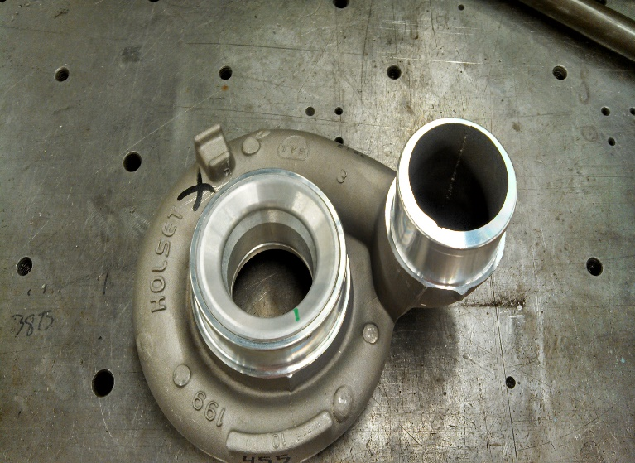
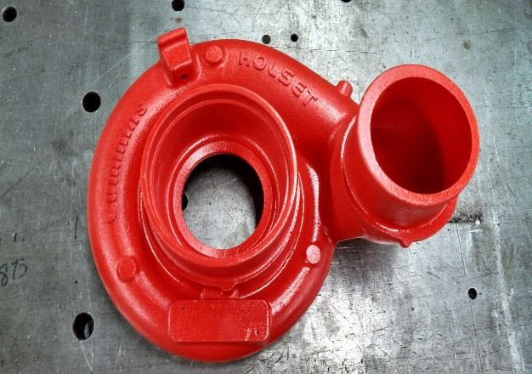
Comparison of Prototype to Original Casing
Fig. 15 Cast Aluminum Casing
Fig. 16 Z-Max Casing
Abiodun Oluwalowo

Slide 23
Future Work Suggestions
Torlon was found to be a suitable material to replace the cast aluminum casing, but it could not provide a financial advantage for Cummins
Future research should be focused on a more effective way of production and manufacturing with cheaper metal alloys
One recommendation could be a more effective method of near net shape forming to obtain efficient cost reduction
Abiodun Oluwalowo

Slide 24
What was learned
The following lessons were learned
Team moral development
We were exposed to several steps that industries use for material selection
We were able to apply Comsol and Finite Element Analysis to real life applications by carrying out burst event analysis on the selected materials.
We also learned how to carry out cost analysis on a particular product
Processes involved in manufacturing such as injection molding, and superplastic forming were analyzed.
Abiodun Oluwalowo

Slide 25
Conclusions
A polymeric material (Torlon) was chosen to be the alternative material to replace the cast Aluminum used for the turbocharger compressor casing.
Torlon as the alternative material was able to withstand the
Maximum Operating Conditions analysis and
Burst Containment Analysis
However ,it was not cost efficient
Abiodun Oluwalowo

Slide 26
References
1. "Turbo Torque." Turbo Torque. N.p., n.d. Web. 21 Oct. 2013. <http://www.mazdarotary.net/turbo.htm>.
2. "Online Materials Information Resource - MatWeb." Online Materials Information Resource - MatWeb. N.p., n.d. Web. 21 Oct. 2013. <http://www.matweb.com/>.
3. "Plastic Sheet, Plastic Rod, Plastic Tubing - Buy Online." Plastic Sheet, Plastic Rod, Plastic Tubing - Buy Online. N.p., n.d. Web. 21 Oct. 2013. <http://www.professionalplastics.com/>.
4. "VICTREX® PEEK Polymers." High Performance Polyaryletherketones, High Temperature Advanced PEEK Polymer, Thermoplastic. N.p., n.d. Web. 19 Nov. 2013. <http://www.victrex.com/en/products/victrex-peek-polymers/victrex-peek-polymers.php>.
5. "Burst and Containment: Ensuring Turbocharger Safety." Turbobygarrett.com. N.p., n.d. Web. 19 Nov. 2013. <http://www.turbobygarrett.com/turbobygarrett/sites/default/files/Garrett_White_Paper_02_Burst__Containment.pdf>.
6. Fagade, Adekunle A., and David O. Kazmer. "EARLY COST ESTIMATION FOR INJECTION MOLDED PARTS." University of Massachusetts Amherst (n.d.): n. pag. Web.

Slide 27
Questions

